Slide 1

Proposal for Power Plant Registration Progress (Construction Phase)

Slide 2


Meetting Among
A Peoples Republic of Bangladesh Registered Consultancy Firm
Supporting national and international projects in Bangladesh for
Registration,
File Processing,
Infrastructure Development And
Industrial Set Up
Our flood light on Power Plant, Green infrastructure, Garments and Leather industry sector
A leading Company in Asia inspired by
Commited to People
Comiitted to Future…………………
More info on www.srclgroup.com

Slide 3
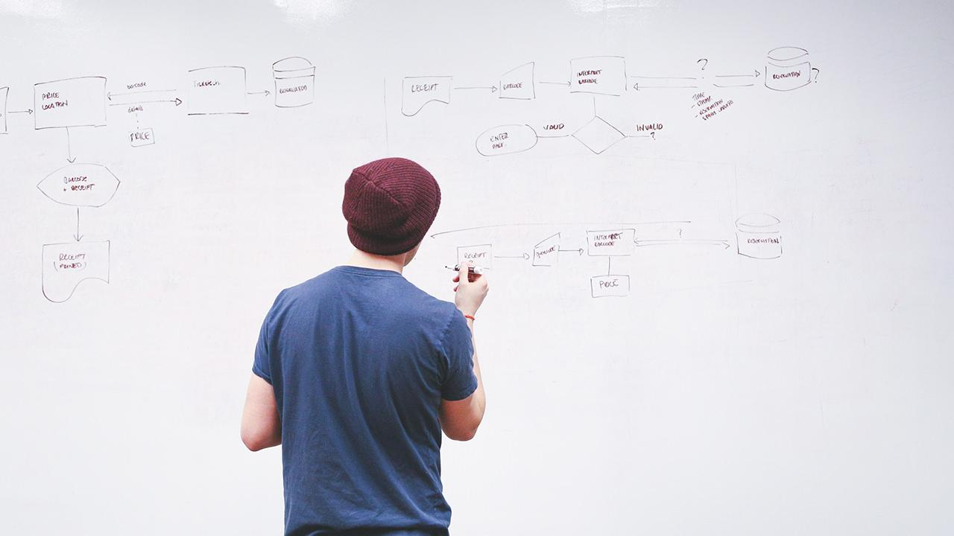
HELLO!
I am Abu Jubayer & my team members are here to discuss with your team
Eng. Badrul Alam (Technical Head _ Power Plant Section)
Eng. Monirul Islam (TH _ Construction)
Md. Mehedi Hassan (Asst. Manager)
You can find me at srcl.group.bd@gmail.com
+88 01711 459 532

Slide 4
Essential Permissions for Matarbari Ultra Super Critical Coal Fired Power Plant, Cox’s Bazar, Bangladesh
Let’s start with the first set of slides

Slide 5
A Short Permission List for Power Plant Construction Period
Sl No. | Item | Required Documents
01 | Construction Area registration | Application form – UP+ DC Office, Trade License, TIN, VAT, Location map, Detail Project Layout, Architectural Layout, Floor Layout, Drawing Sheet – Section and Elevation, Land Acquisition Clearance, Mauza Map, Soil Test Report, Structural Drawing
02 | Temporary Water supply for construction/Commissioning | Deep tube well _ DPHE, BADC Permission, Submersible _ No Permission + Item. No. 1 Doc 250 M Radius Distance area map

Slide 6
Continuing
03 | Temporary waste water /Sanitation discharge | Source of waste water, amount of waste water, discharge layout, any ETP/Open discharge, DPHE, DoE No 1 Doc
04 | Temporary Telephone Infrastructure | BTCL, Telephone Exchange Department Tower Drawing/Layout, Capacity
05 | Temporary Electricity | REB/PDB- Demand for temporary electricity consumption, layout electrical & Civil, single line diagram, Location Map, DoE Clearance for temporary line
06 | Permanent building Facilities/utilities | After Completing the Temporary Submission
07 | Permanent Water supply | After Completing the Temporary Submission

Slide 7
Continuing
10 | Construction Work | N/A (Permission from MJVC)
11 | Firefighting system | FSCD- District Office/ Divisional Office
12 | Permanent Telephone Infrastructure | After Completing the Temporary Submission
13 | Chemical license | DOE, DC Office, Chemical Stake Yeard details, Layout plan Item Test Result Traveling Routes Handling Procedure Personal Protective Equipment (PPE) Details Operation Personnel details (qualifications, trainings and other certifications)
14 | Building and Architecture | Marge with Item No. 01

Slide 8
Continuing
15 | Boiler | Boiler Audit Office
16 | Jetty | Port Authority Chittagong
17 | Port Authority | Port Authority Chittagong
18 | Bangladesh Navy | Navy Headquarter and Cox’s Bazar Division
19 | Bangladesh Police | District Police and Headquarter
20 | KPI | Key Point Installation (Ministry of Home Affairs )
21 | BoI | Board of Investment
22 | Coast Guard | Coast Guard Headquarter and Chittagong Division
23 | Bangladesh Answer Deployment | Anser VDP Headquarter and Adjutant office Cox’s Bazar and Chittagong Company Headquarter
24 | Channel Clearance | Port Authority/ BIWTA

Slide 9
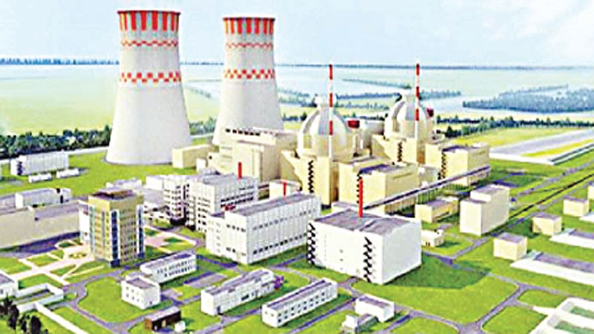
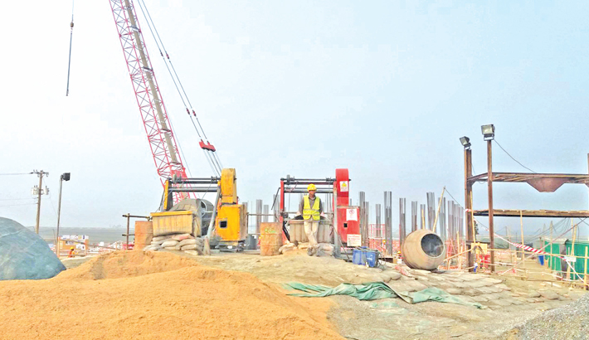
BIG CONCEPT
Large Structures needs Extra-Large Supports

Slide 10
Consultant Part Input
Table Work
Documentation Assembling
Finalize the contact offices & persons
Help to manage the documentation
Half monthly progress report submission
Finalize the client requirements
Any other short survey documentation
Operation
Fill up and submission of the prescrived form
Trace the file processing way and update the report
Negotiation with every relevant officers and offices
Disbursed govt. fees and other amount in due time
Final the approvals and certficates

Slide 11
Inputs from Toshiba
Make a Deal
Funds & Other
Disbursed the counted funds ASAP basis
Before 7 days Knock the SRCL if any problems are generated
Attend the meeting in govt. office if required
Arrange the field visit if necessary
Documentation
Support the required documents
Review the regular updates and send feedbacks

Slide 12


We are Here

Slide 13
And we are simple
Contarct with SRCL
Documents Processing in Govt. Office
Final
Approval

Slide 14
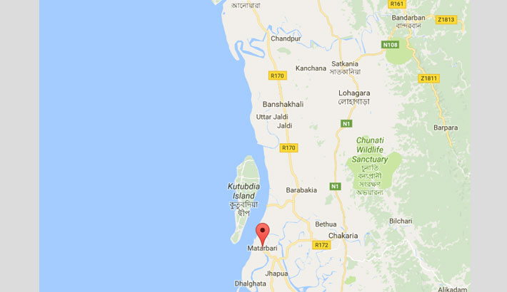
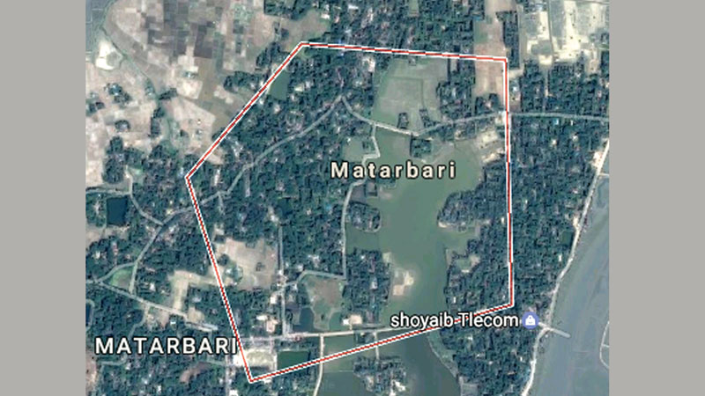
Maps
our office

Slide 15
$4.6 b
That’s a big number for a project,

Slide 16
Let’s review Our Strength
25 Senior Consultants
5o Govt. Office liasion
Legal and Govt. Aprroved
110 Field Level Contracts
Time & Team Management
International Standard

Slide 17
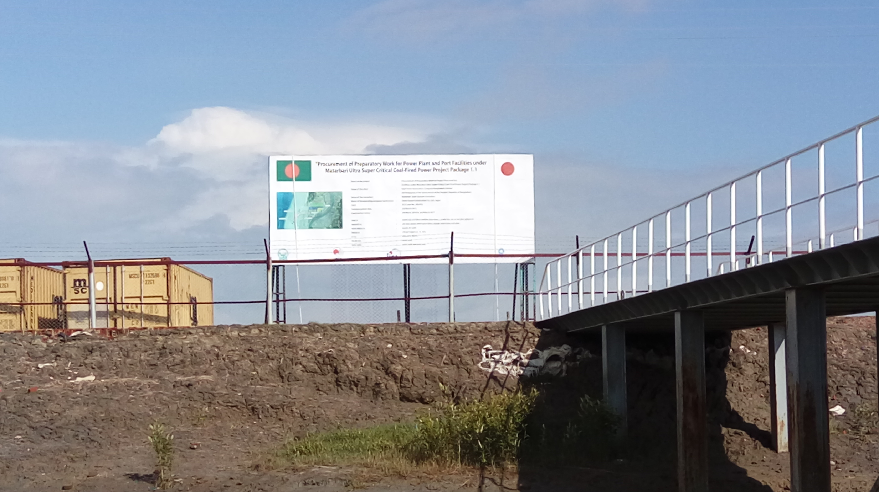
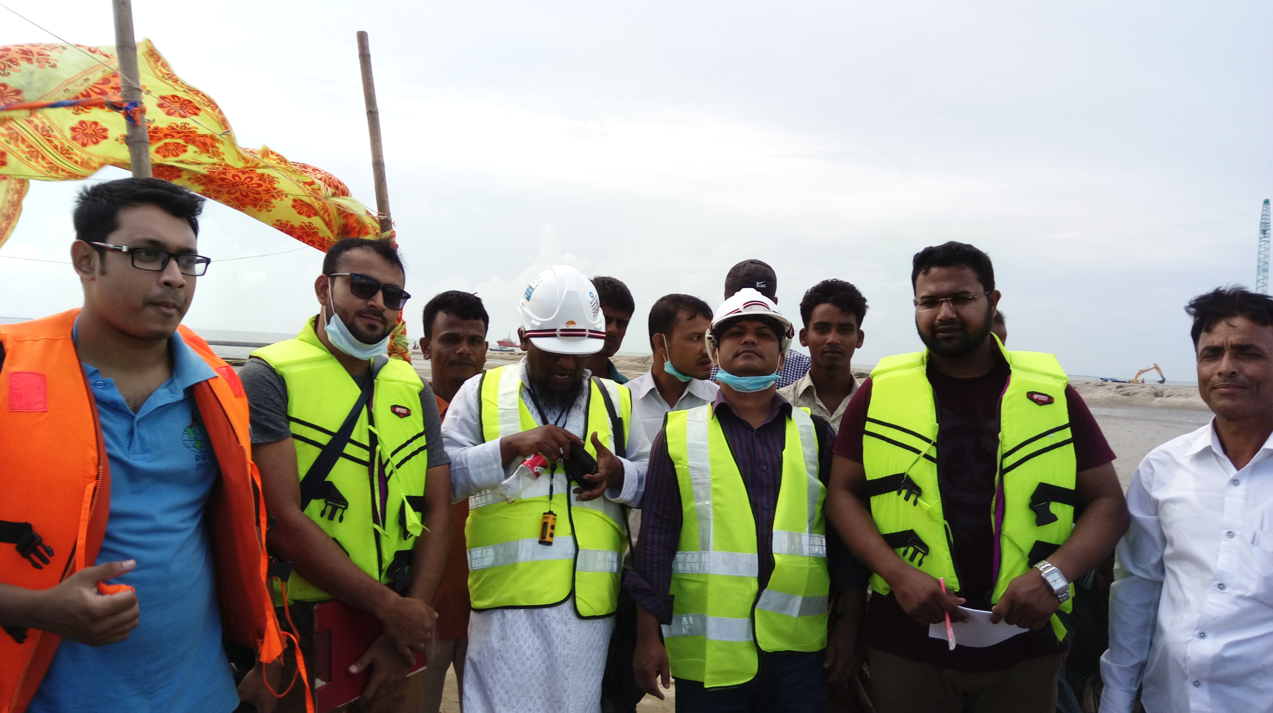
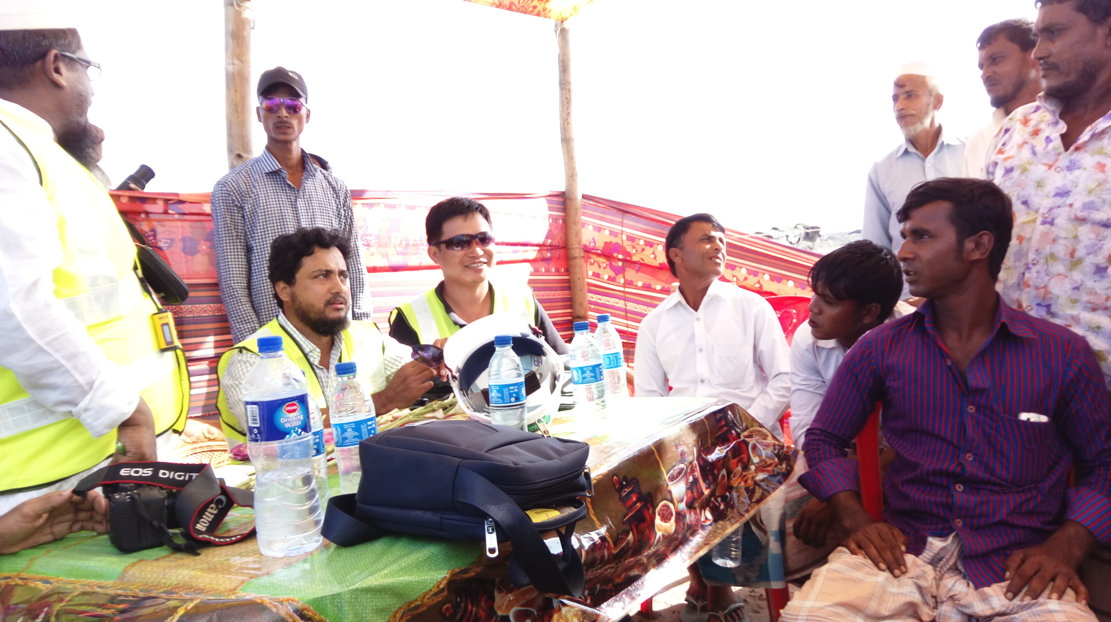
Some Previous Project Photograph

Slide 18
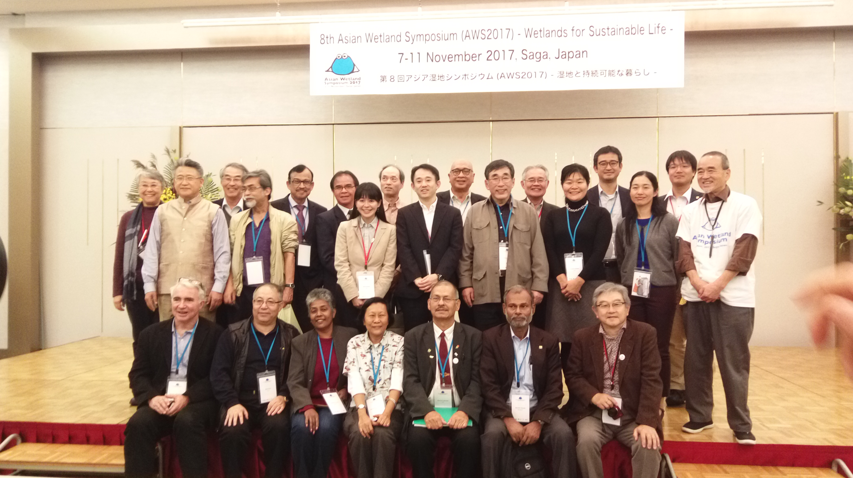
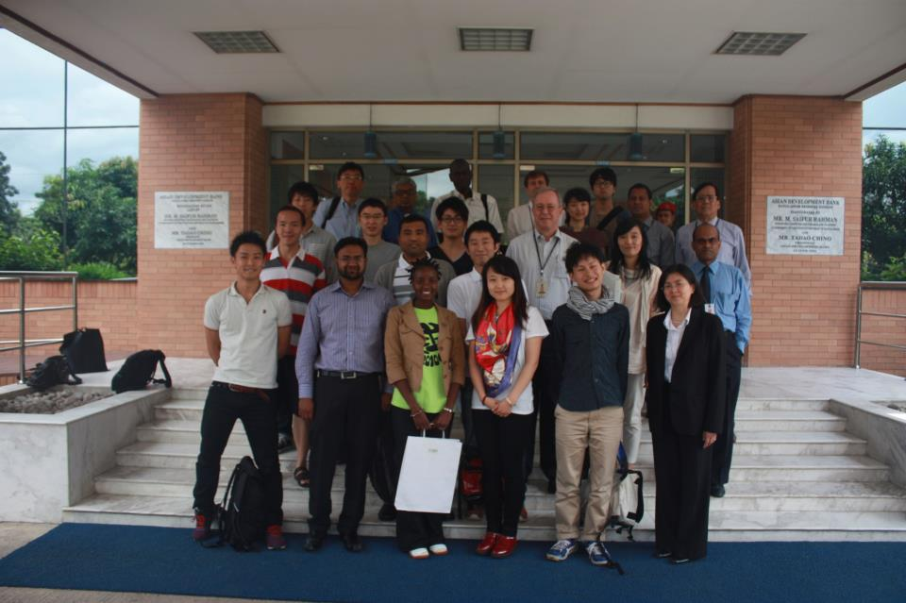
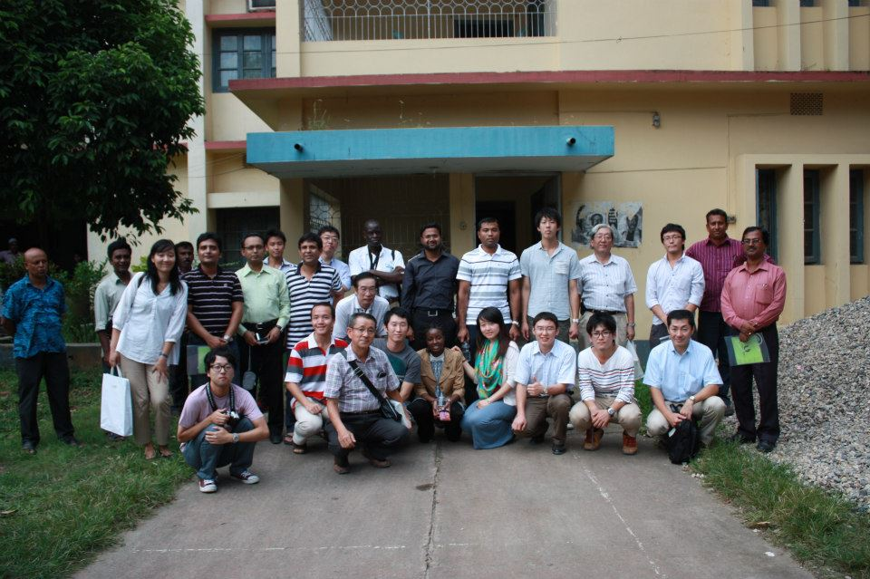

Slide 19

Lets start a
PROJECT

Slide 20
THANKS!
ありがとうございました
Arigatōgozaimashita
Many questions?
You can find me at
Sustainable Research and Consultancy (SRC) Ltd. ,
House # 28, 4th Floor), Karwan Bazar, Dhaka- 1215, Bangladesh. Cell 1 # +88 01711 459 532
Email: srcl.group.bd@gmail.com,
Web: www.srclgroup.com

